Slide 1
Telecom Industry Churn Report

Slide 2
Problem Statement
In the telecom industry, customers are able to choose from multiple service providers and actively switch from one operator to another. In this highly competitive market, the telecommunications industry experiences an average of 15-25% annual churn rate. Given the fact that it costs 5-10 times more to acquire a new customer than to retain an existing one, customer retention has now become even more important than customer acquisition.
So To retain the customer ,first of all we have to analyse the sentiment of the customers so based on that we can provide them some offers to satisfy.
To reduce customer churn, telecom companies need to predict which customers are at high risk of churn.
In this project, you will analyse customer-level data of a leading telecom firm, build predictive models to identify customers at high risk of churn and identify the main indicators of churn.

Slide 3
Task
From the given data it is clearly mentioned that i have to Define the churn Features (i.e label column) to predict the churn
Step 1 : To do Feature Engineering for the data and to create the new label column for the model training
Step 2: To do the Null value check and Outlier detection and do the imputation and also to find the numerical and categorical features and convert that into numerical form by using dummy variable trap technique
Step 3: To do Exploratory Data analysis about the data to understand the pattern of the data.

Slide 4
Step 4 : If the shape of the data is more we have to reduce the dimension so for that we have to use PCA (Principal Component Analysis)
Step 5 : To split the data into train and validation
Step 6 : To train the model and Evaluate the model performance
Step 7 : If the model Performance is no satisfied the we have to retrain using Tuning technique by Grid search cv …
Step 8 : we have to pickle the model for the production

Slide 5
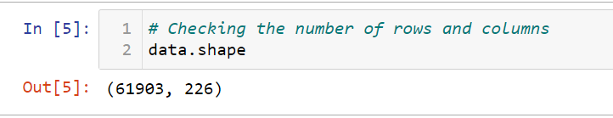
Feature Engineering
Checking the no of rows and Columns :
It was having 226 Columns so we have to remove the unwanted columns so we have to definitely to use PCA

Slide 6
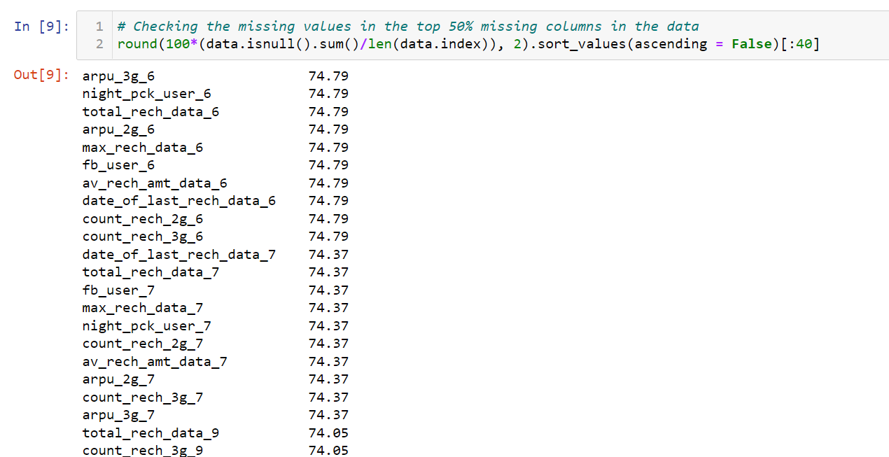
Checking the missing values in the top 50% missing columns in the data
40 columns are having the missing values above 50%

Slide 7
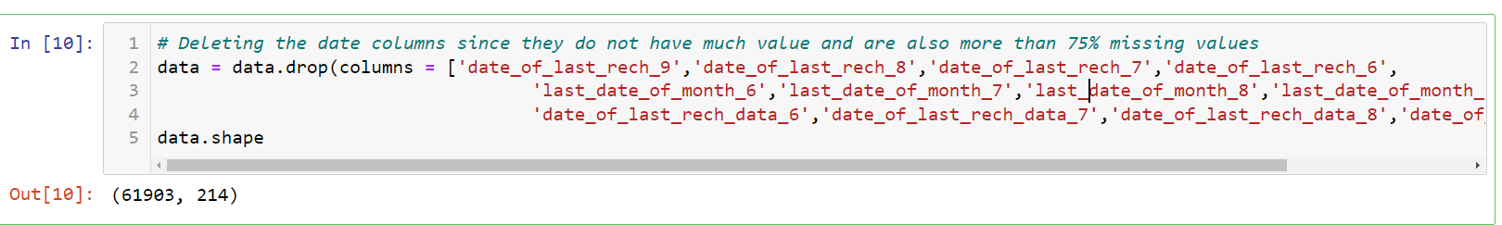
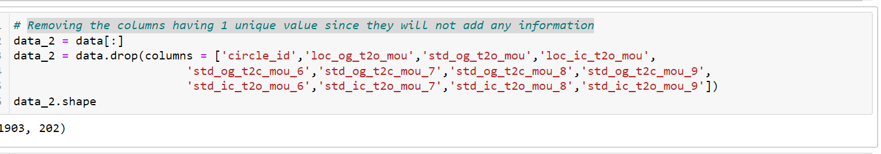
Deleted the date columns since they do not have much value and are also more than 75% missing values
Now the shape has reduce to 214
Removing the columns having 1 unique value since they will not add any information

Slide 8
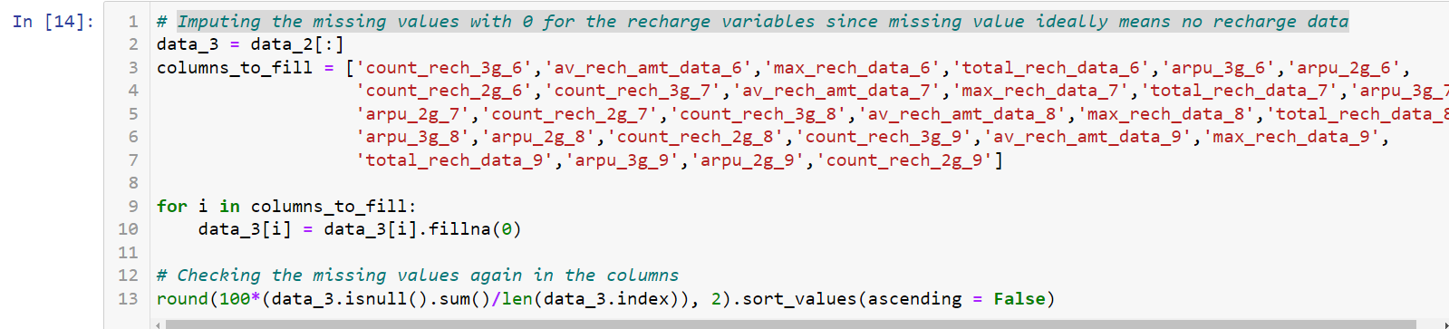
Imputing the missing values with 0 for the recharge variables since missing value ideally means no recharge data

Slide 9
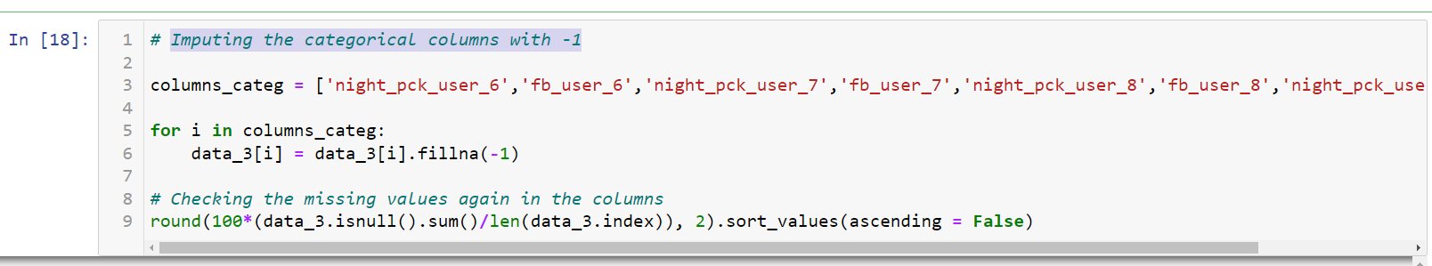
Imputing the categorical columns with -1
So while doing dummy variable trap it will give less weightage and it will remove that column
After inputting converted the column into Object data type

Slide 10
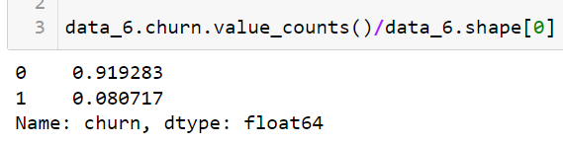
Filtering High Value Customers and creating the Label column for Classification problem
So based on 9 th month Calls and Data usage i have calculated the Churn columns so for that.
I have taken total incoming and outgoing call rate as total call for month 9
And for data volume consumed as bean taken as total data for month 9
So with respect to that made and if condition states that if total call and data usage is 0 means label it as 1 are else label it as 0
After creating this we have drop the 9th month columns because
The business objective is to predict the churn in the last (i.e. the ninth) month using the data (features) from the first three months

Slide 11
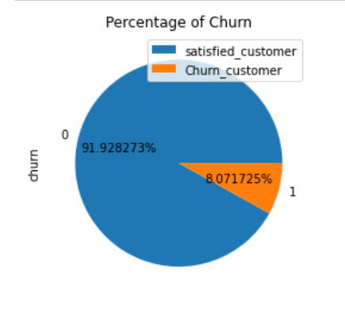
EDA
Plotting the pie chart for Churn column
It is shown that around 8 % of the people are not using the network properly by they are the customer of the company

Slide 12
Outlier Detection:
All the columns have high outliers based on the plots and we need to do the outlier treatment of the numerical columns
Treated the outliers with the quentile range
People giving low Average revenue per user and low recharges have higher churn rate
There is high churn rate in the users that do not use Call or Internet services although they are very less people. There is a high churn rate in the customers having low No_days (i.e. 0-450)¶

Slide 13
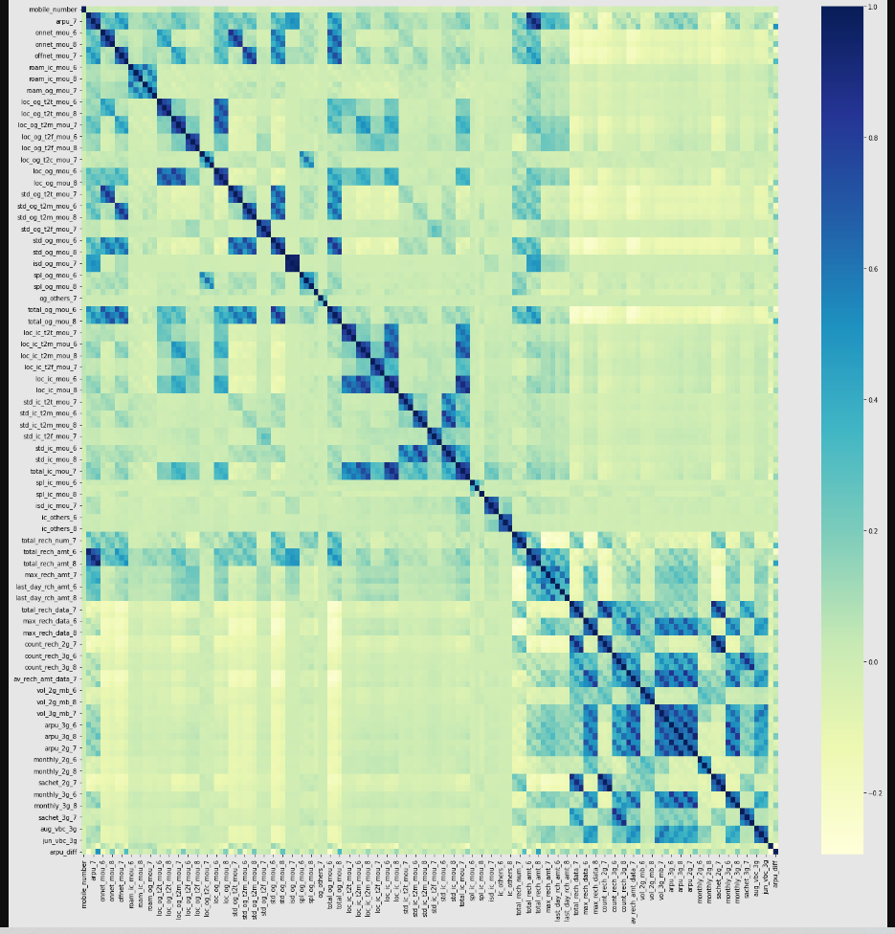
Mostly all the variables (for the month of June, July and August) have high correlation with each other which is natural since the usage or amount mostly remains the same per user. However, there is a high correlation amongst 3g volume, 2g volume and Average revenue per user. We will deal with this while doing PCA and VIF in high interpretability models.

Slide 14
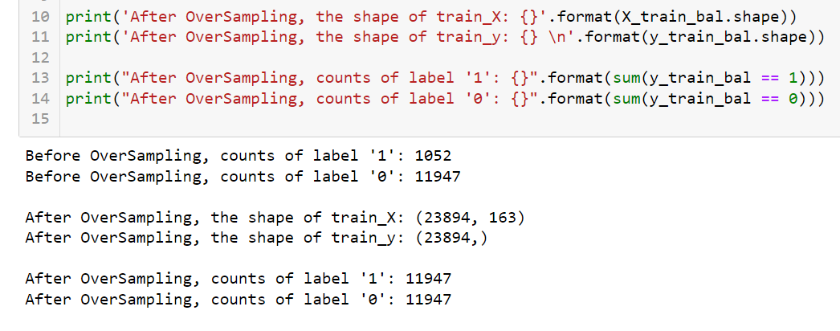
Training the model:
Before Training have to scale data then using somte technique we have to make balance the data

Slide 15
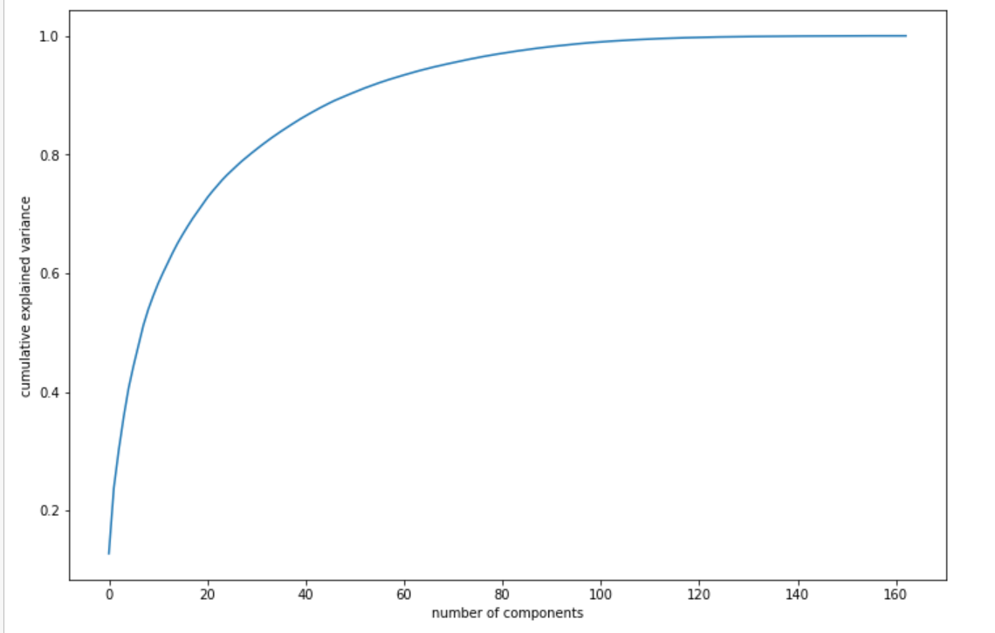
Then we have to Use the PCA :
We are making the 60 principal components , it was showing the variance of 90%And it get reduced to the dimension of 60 features

Slide 16
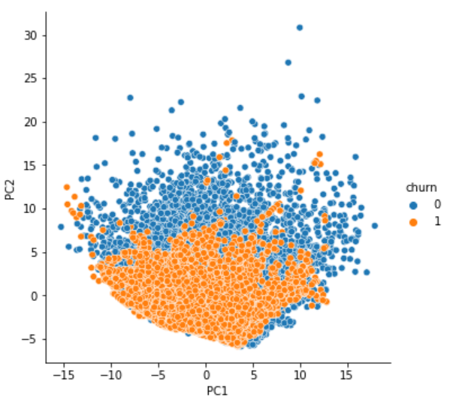
Visualizing the principal components with respect to churn

Slide 17
Trained the model with Logistic regression and Random forest
Logistic Regression
Trained with Default parameters and tested the model and evaluated with the confusion metrics it was given the accuracy range of 0.82 %
Random Forest
Trained with Default parameters and tested the model and evaluated with the confusion metrics it was given the accuracy range of 0.91 %

Slide 18
Conclusion:
After this we have to do hyper parameter tuning to increase the performance of the model then we have to pickle the standard model for the production

